Slide 1
Post Harvest Handling of Flowers and Foliage
- From the Field to Chelsea

Slide 2
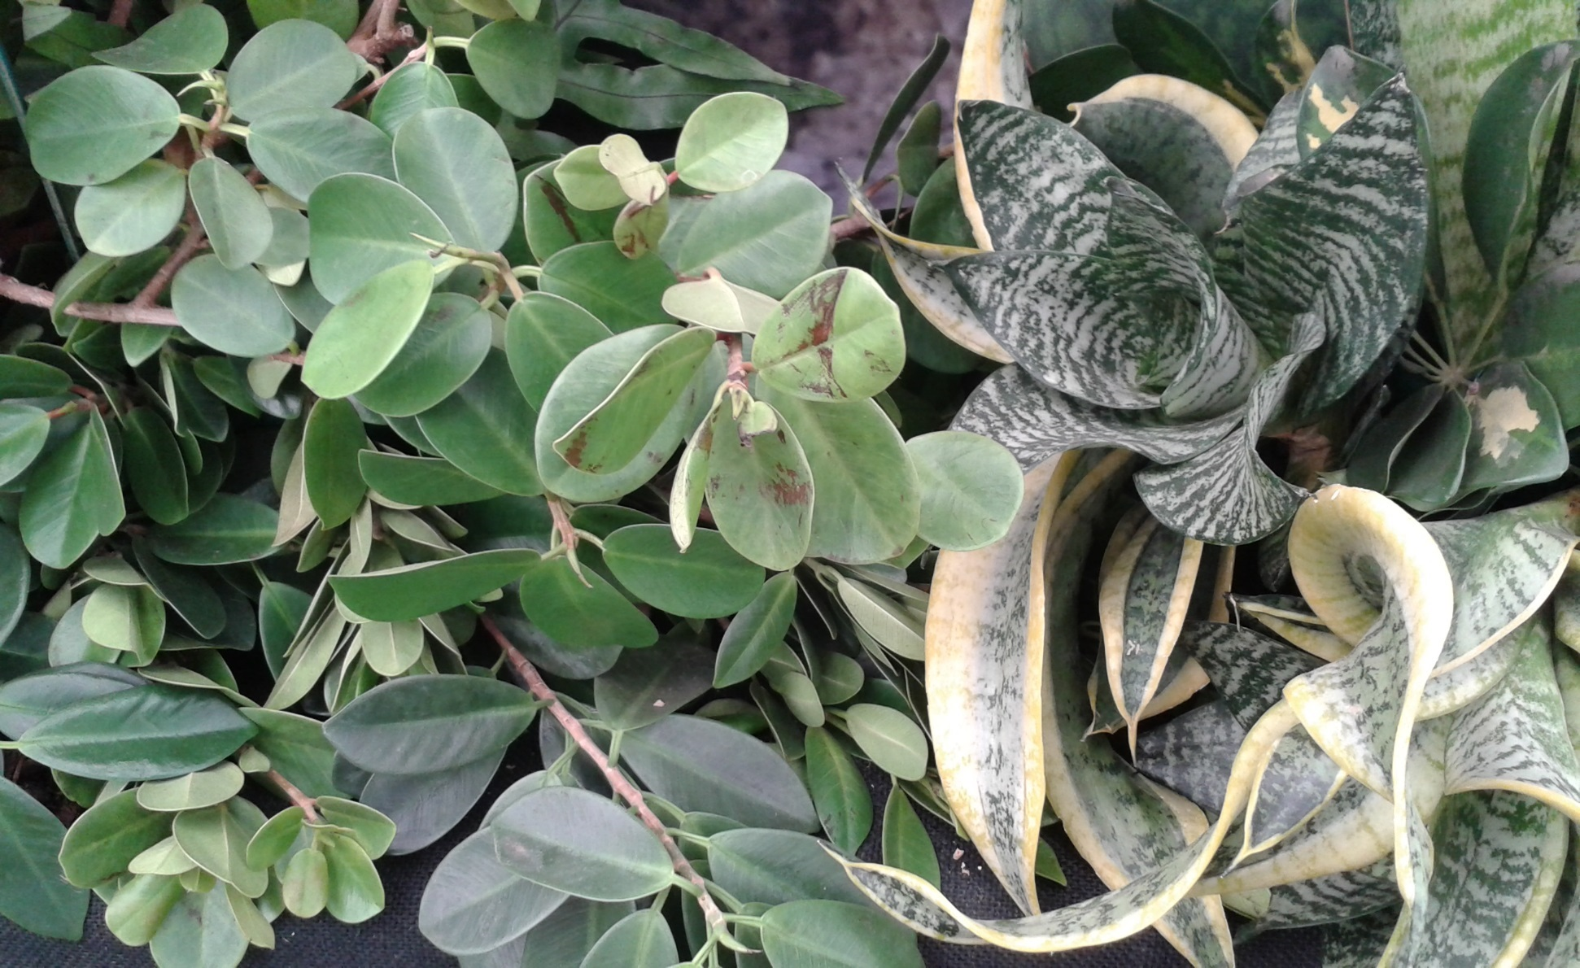
Chelsea 2015

Slide 3
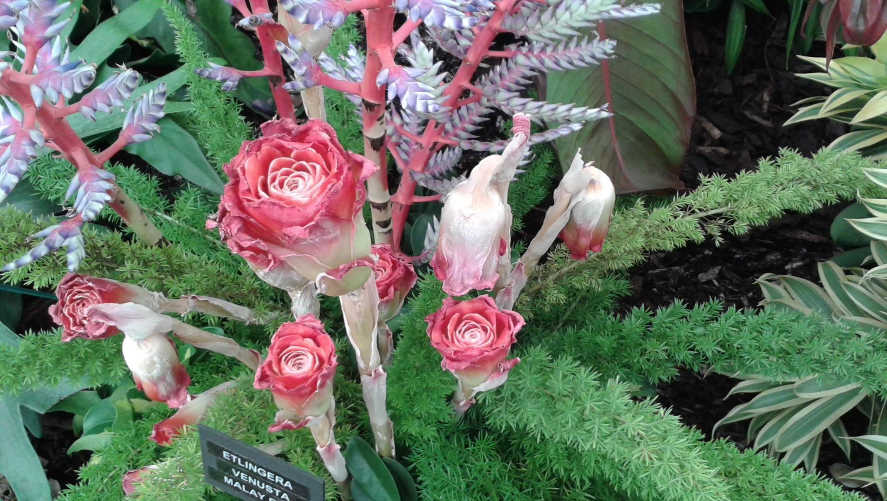
Chelsea 2015

Slide 4
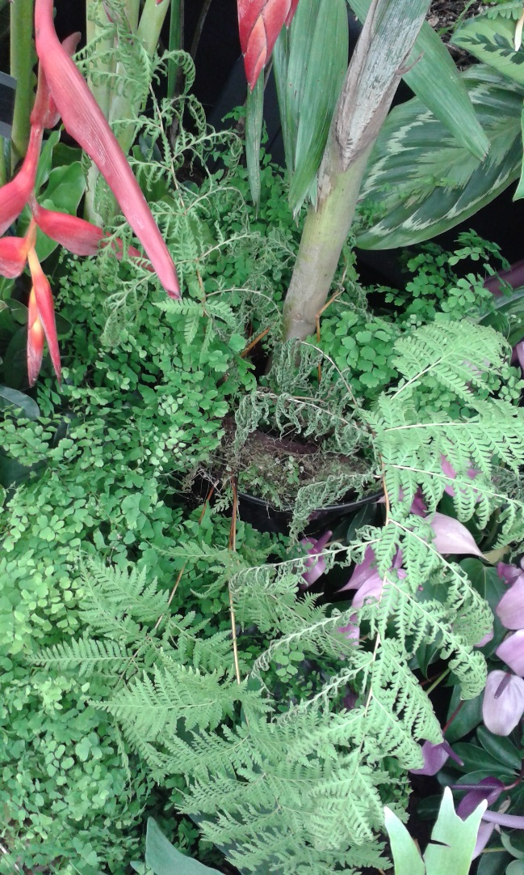
Chelsea 2015

Slide 5
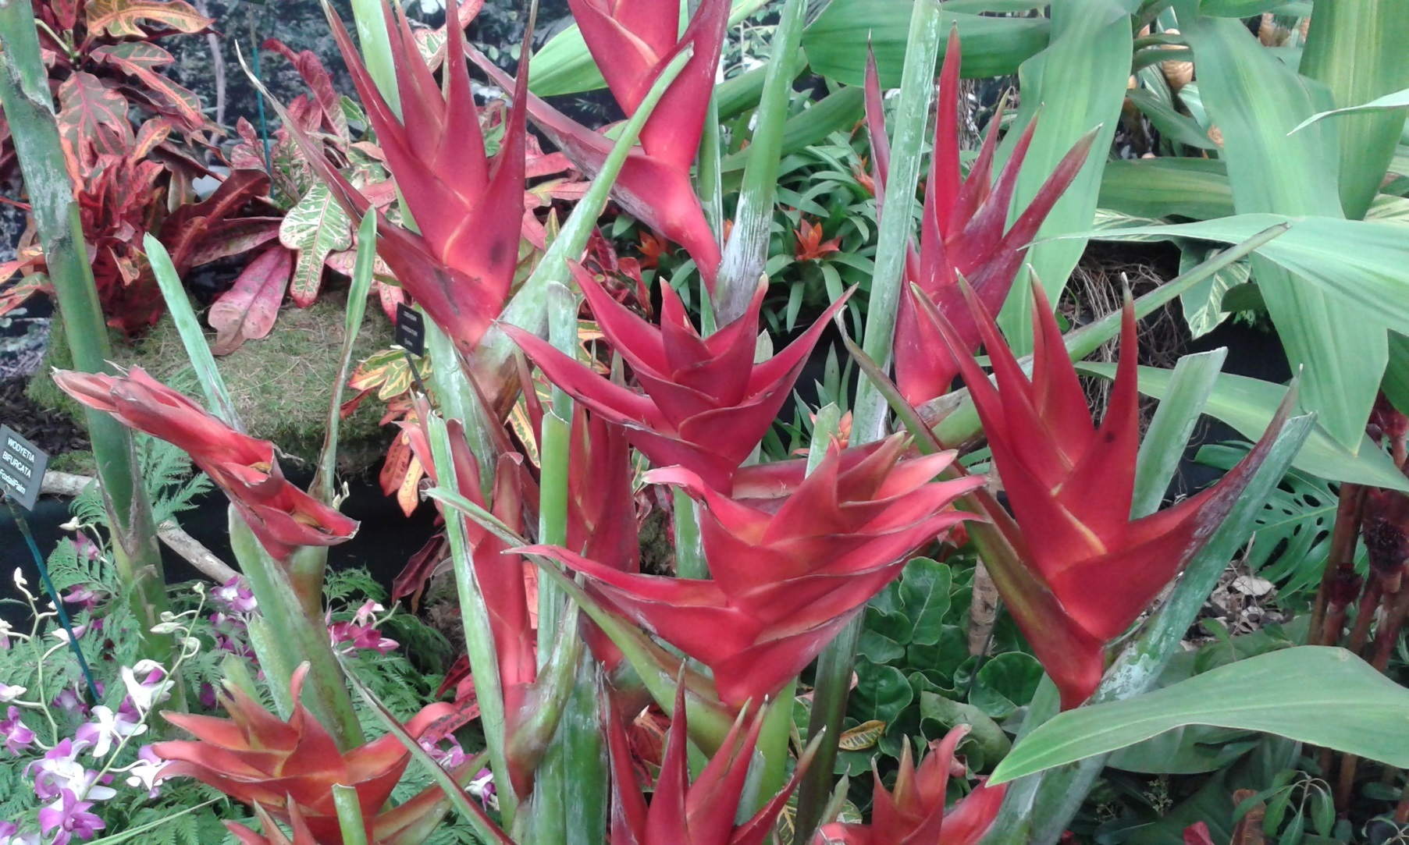
Chelsea 2015

Slide 6
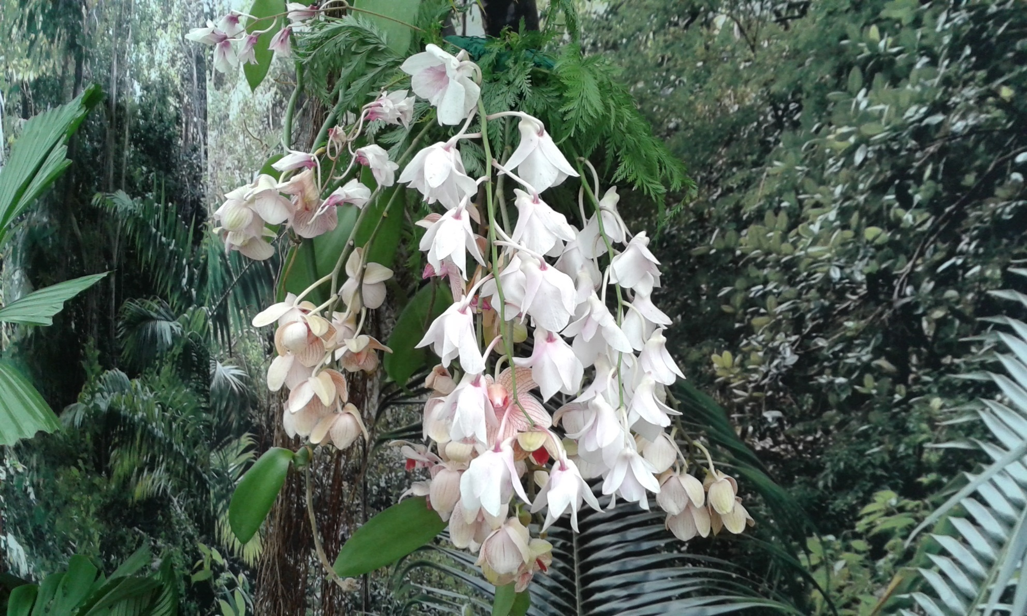
Chelsea 2015

Slide 7
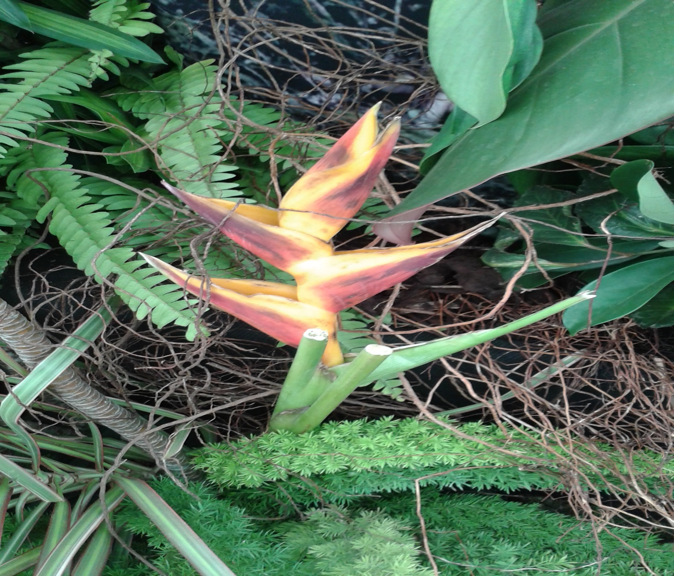
Chelsea 2015

Slide 8
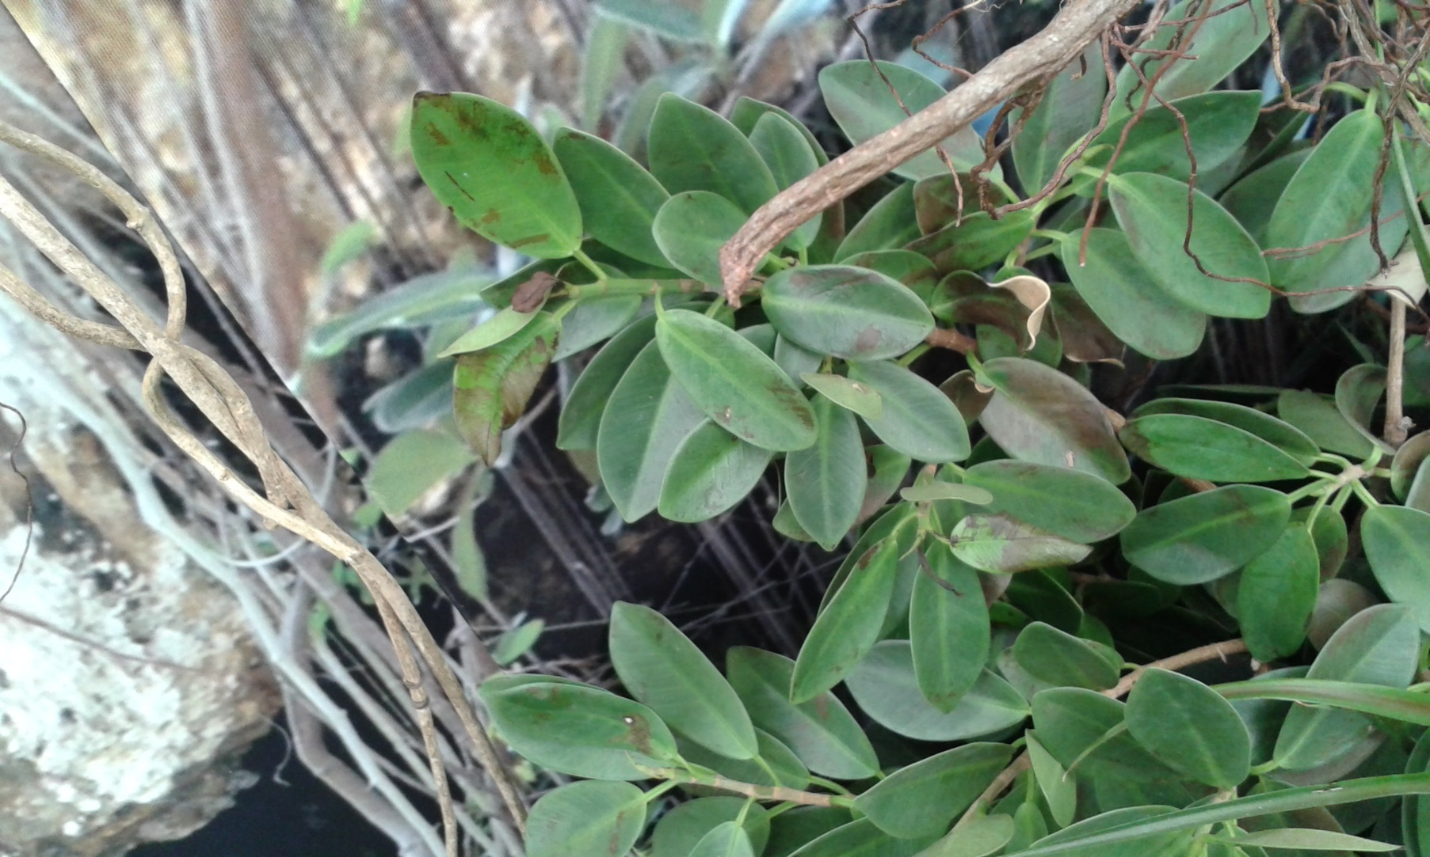
Chelsea 2015

Slide 9
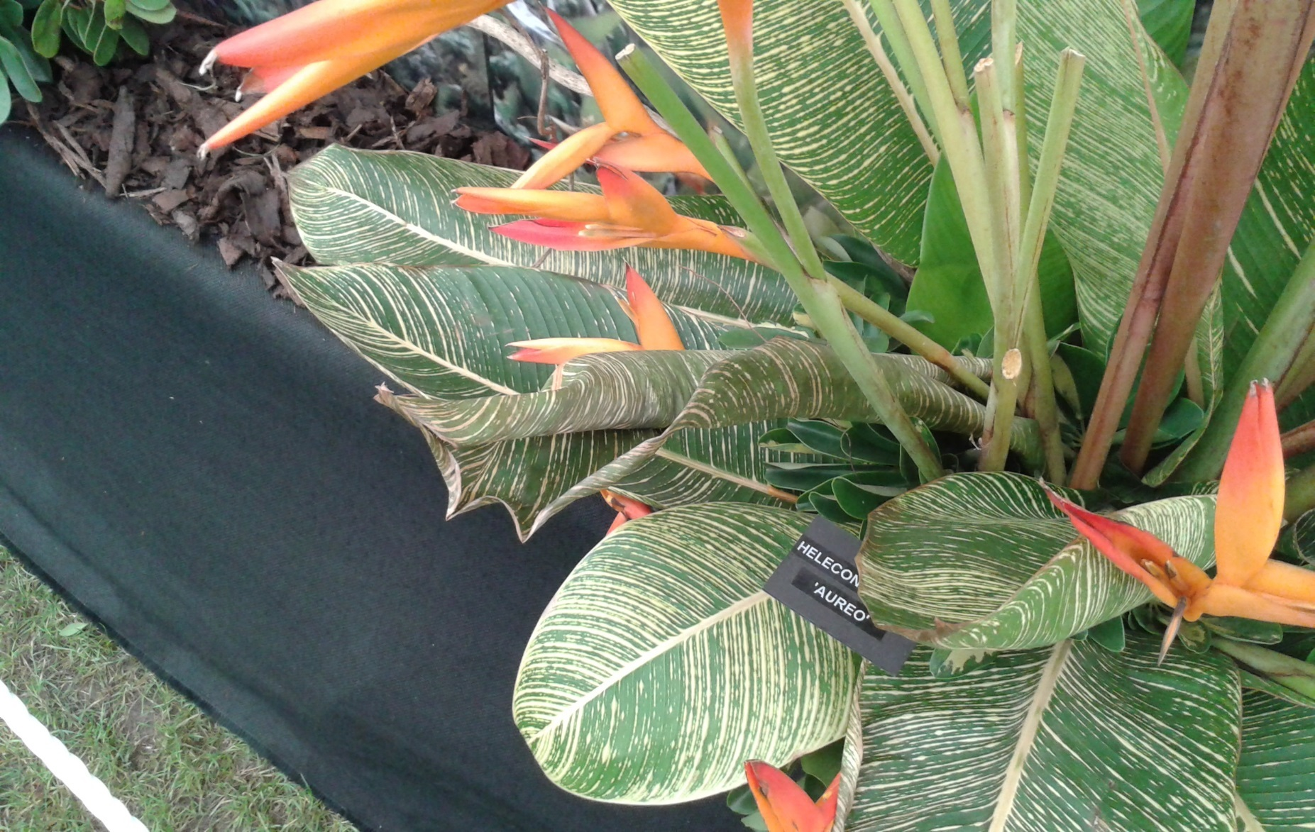
Chelsea 2015

Slide 10
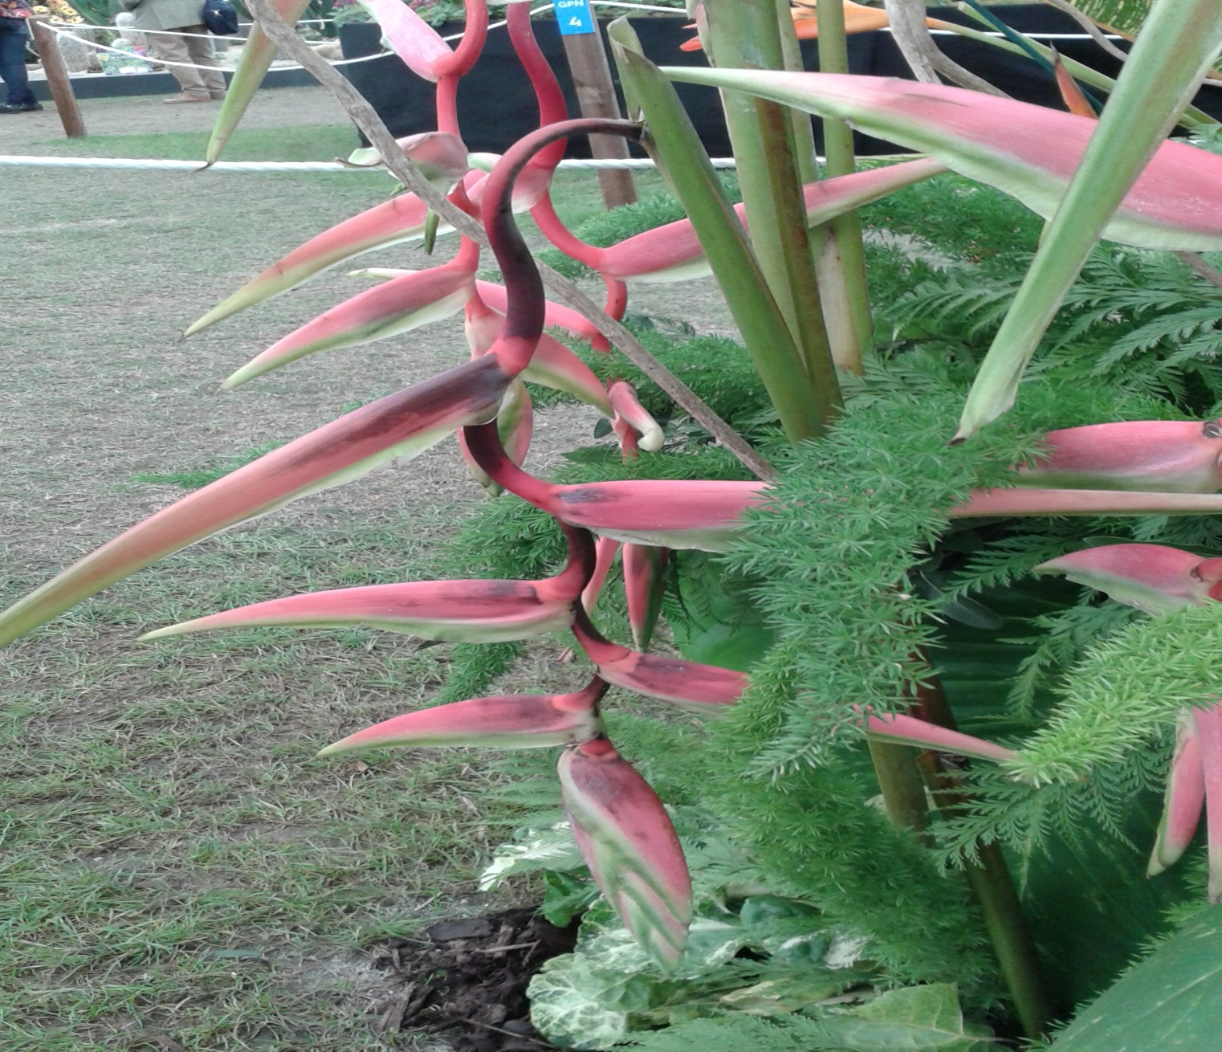
Chelsea 2015

Slide 11
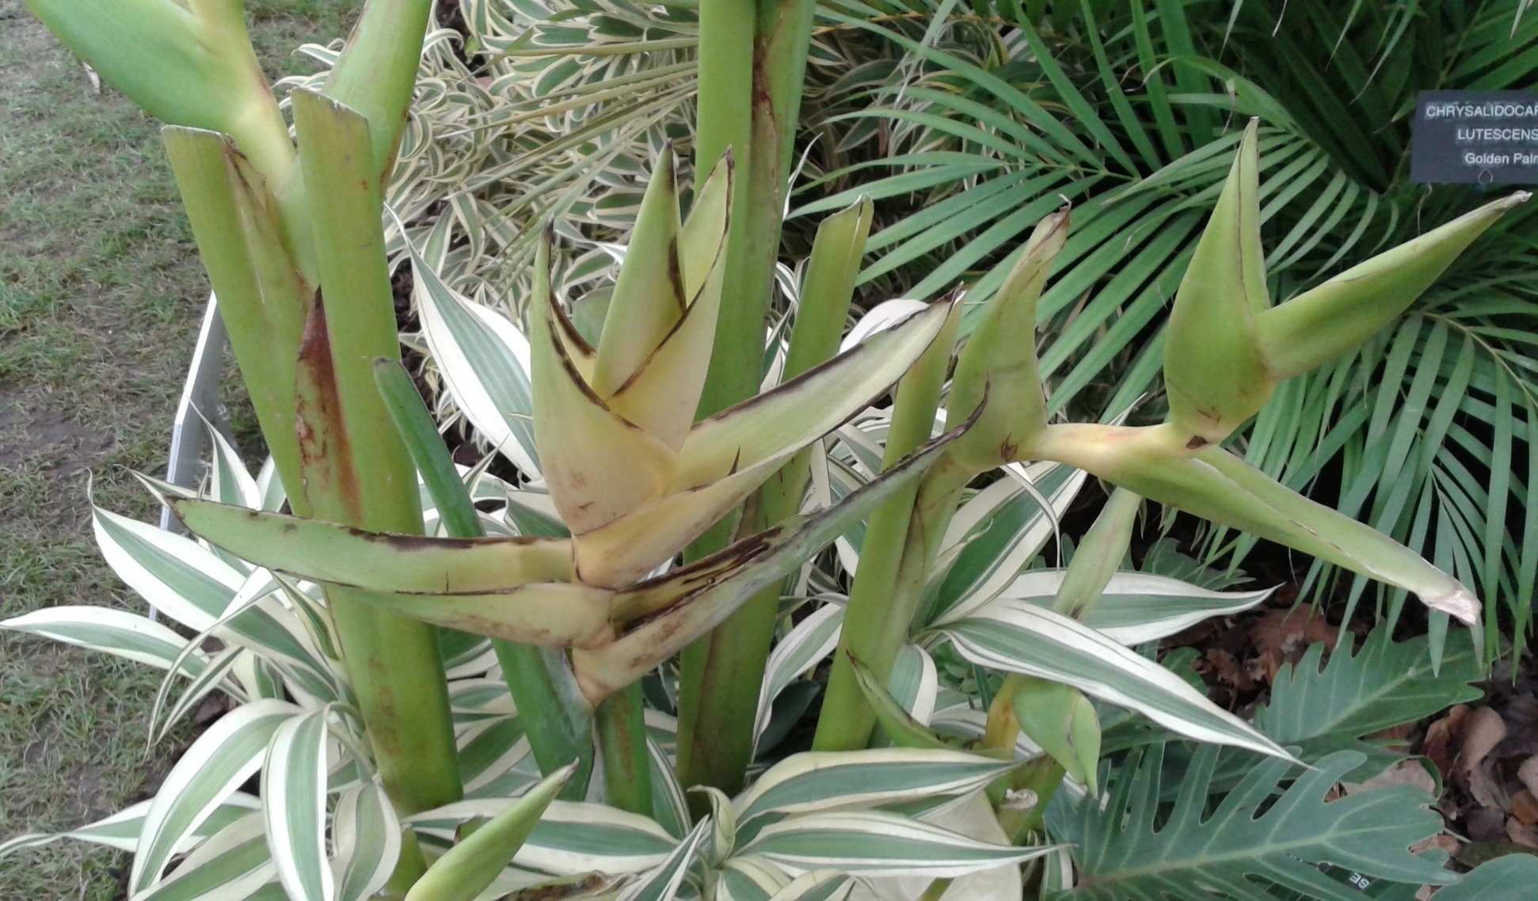
Chelsea 2015

Slide 12
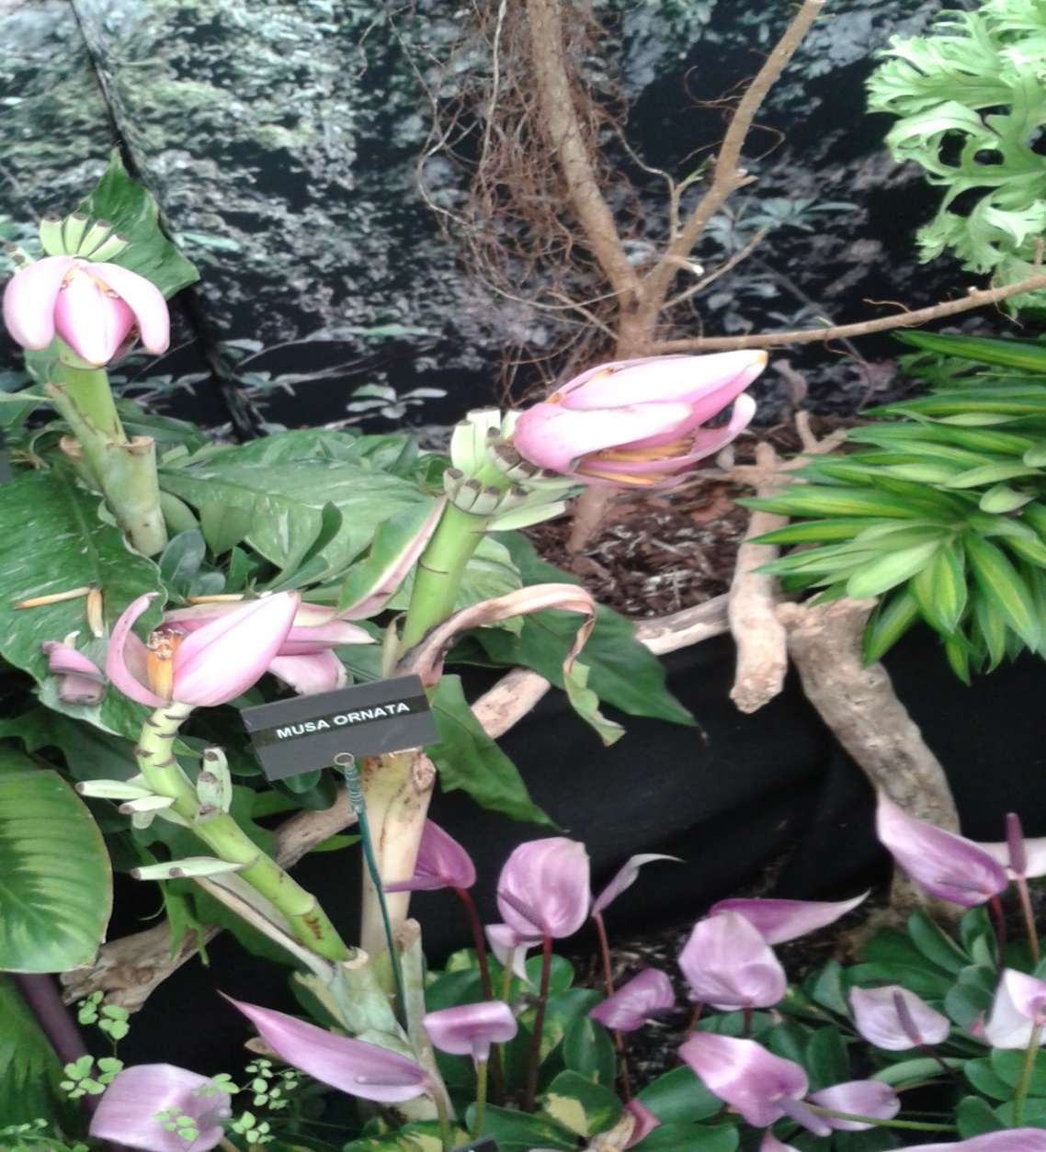
Chelsea 2015

Slide 13
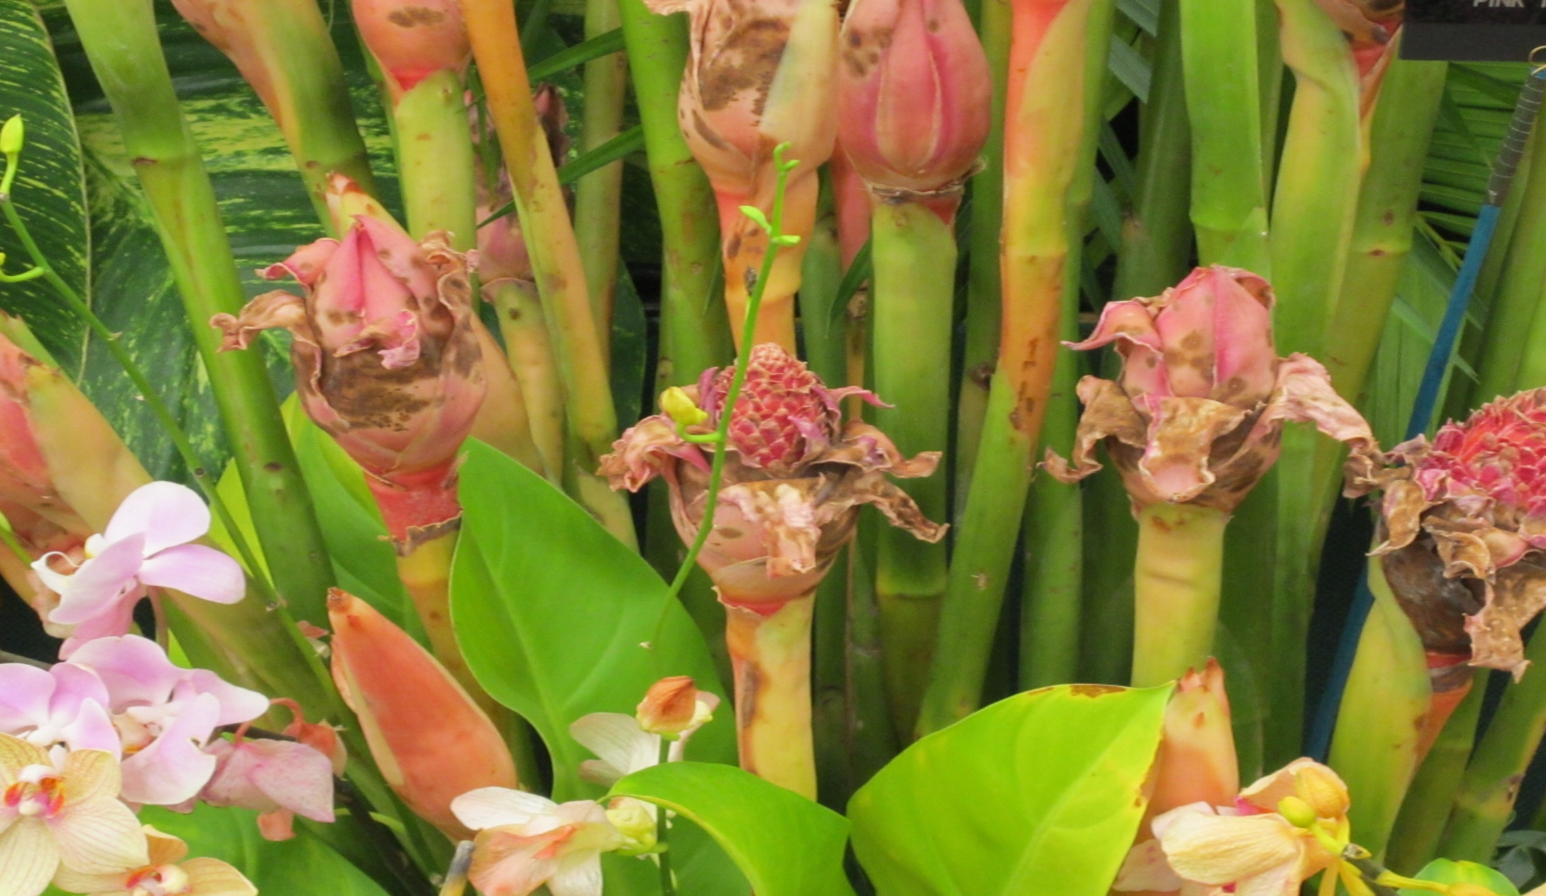
Quality Problems 2012
Encouragement of the production of local food crops, especially vegetables
Development of irrigation systems

Slide 14
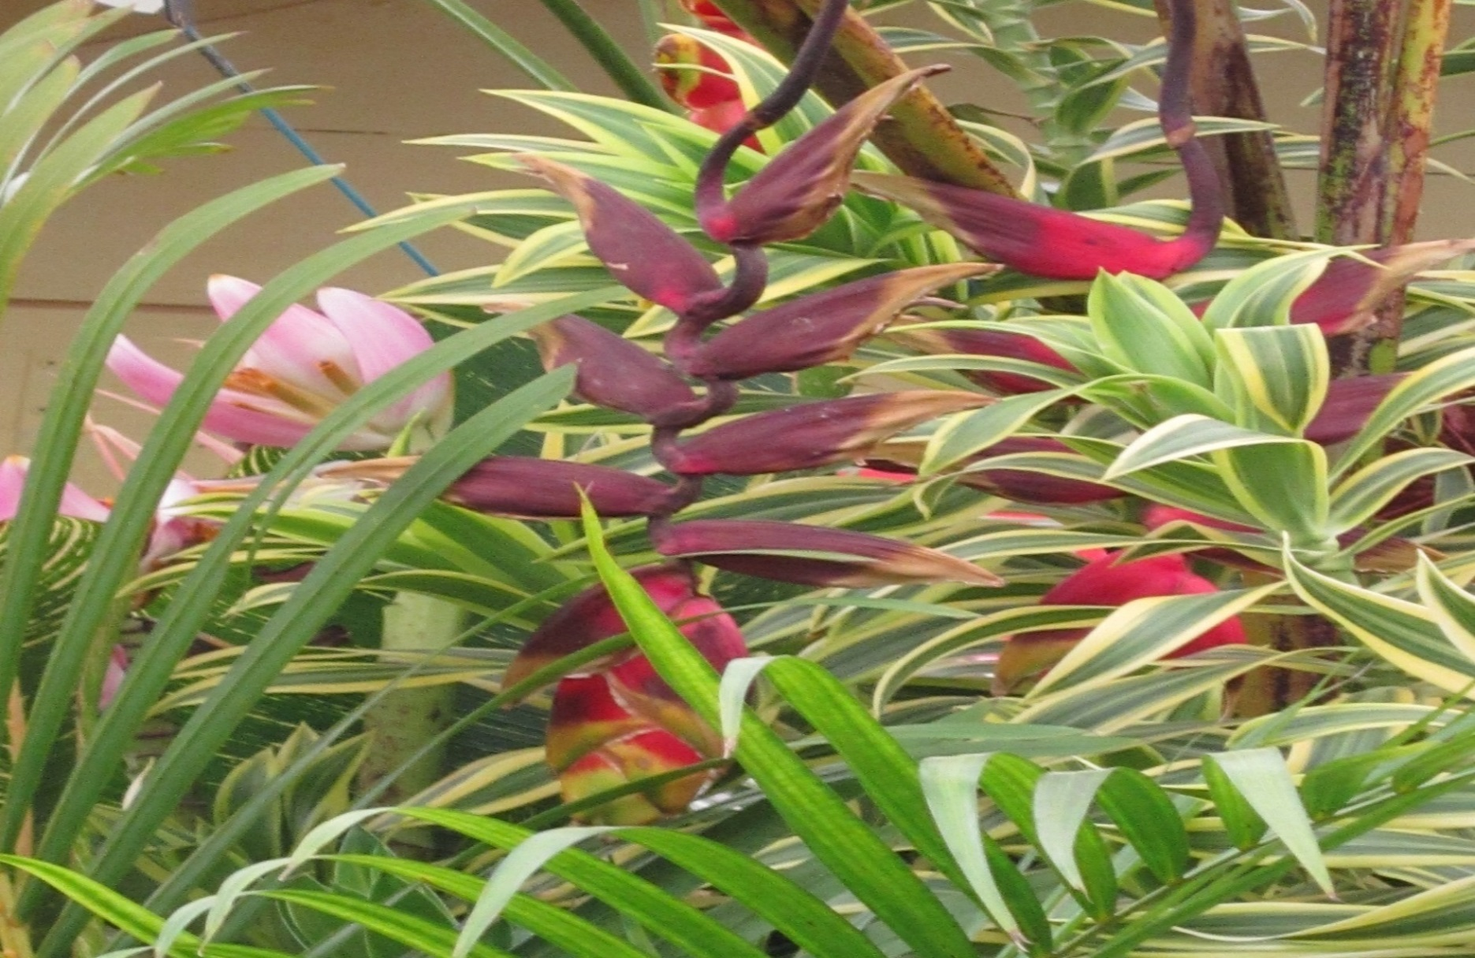
Quality Problems 2012

Slide 15
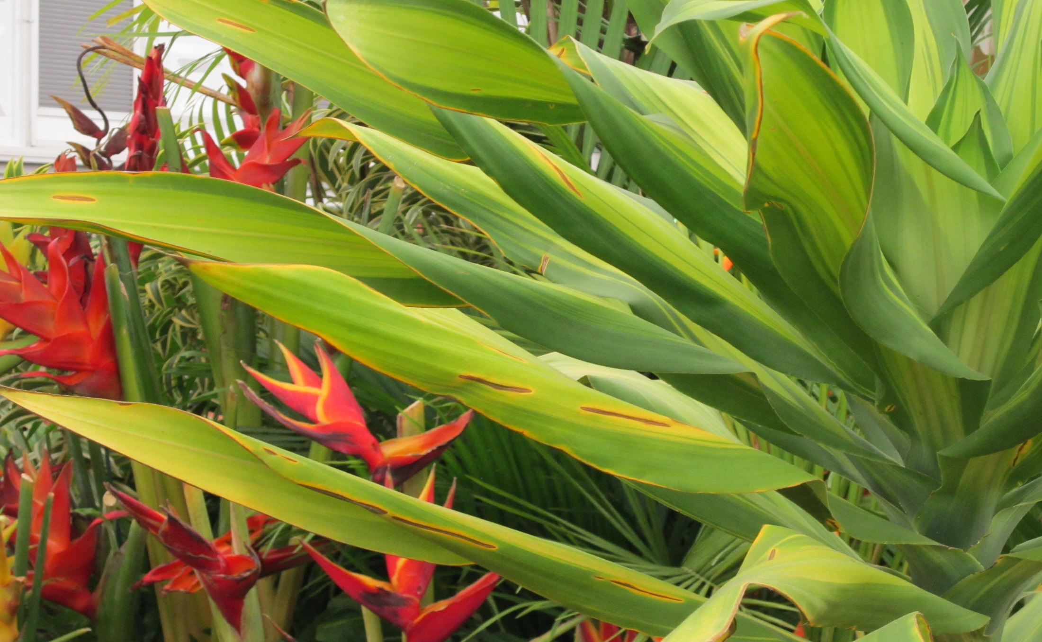
Quality Problems 2012

Slide 16
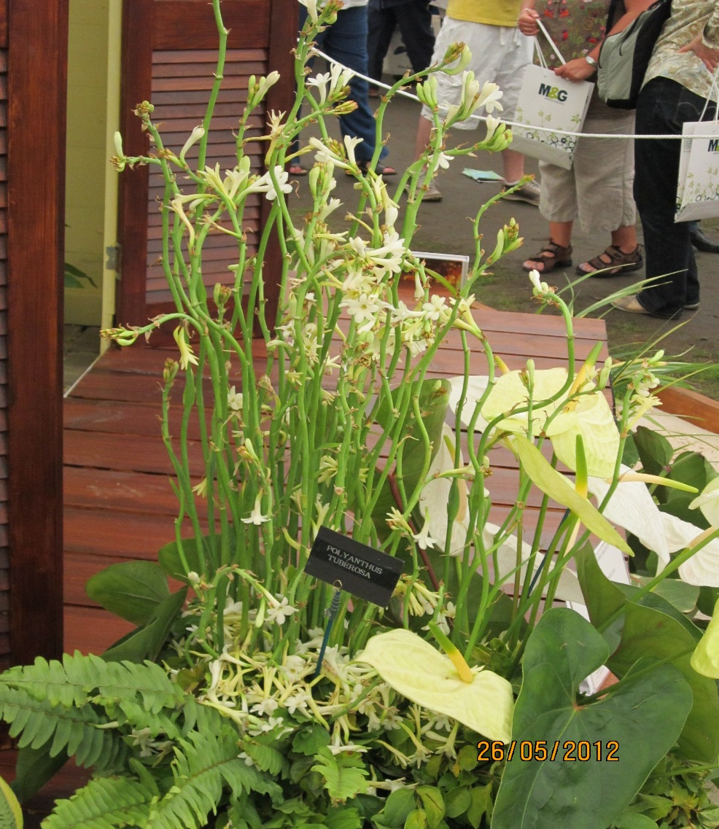
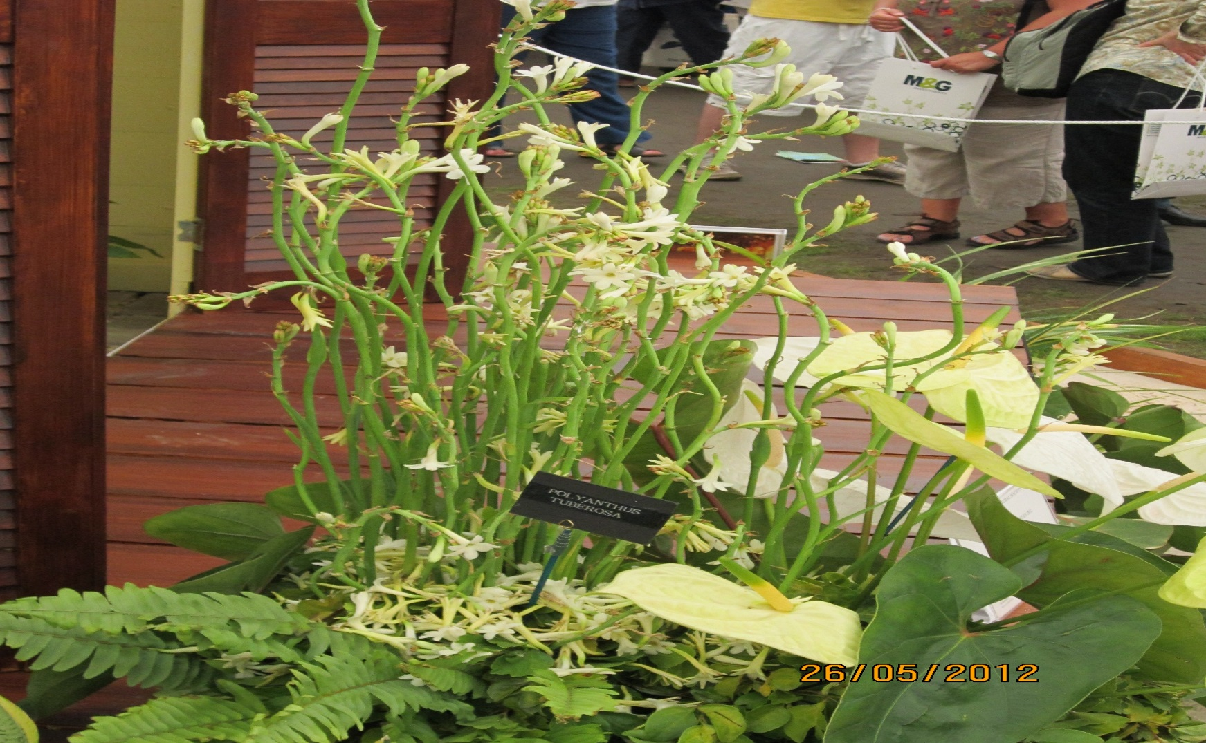
Quality Problems 2012

Slide 17
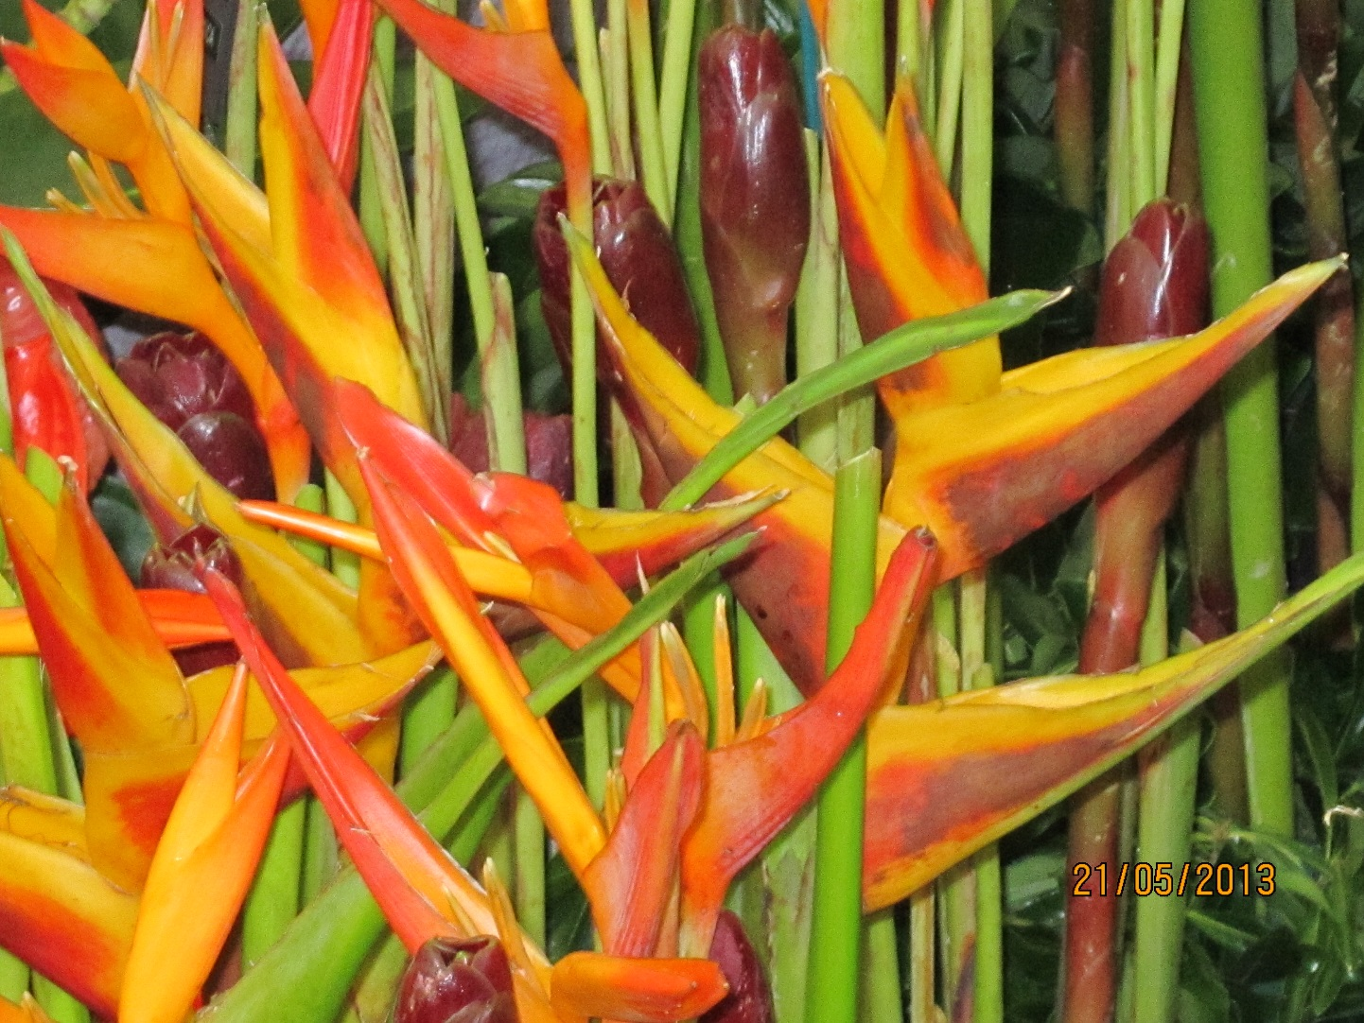
Chelsea 2013

Slide 18
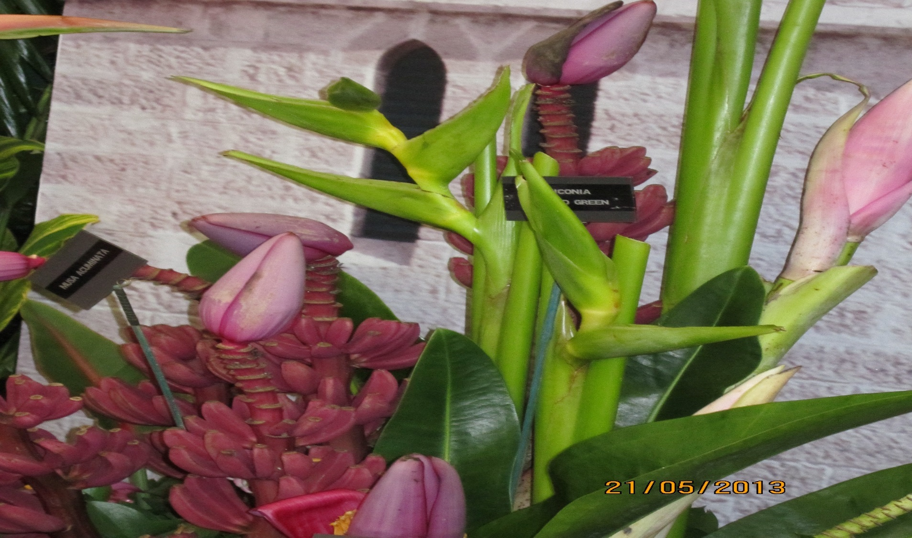
Chelsea 2013

Slide 19
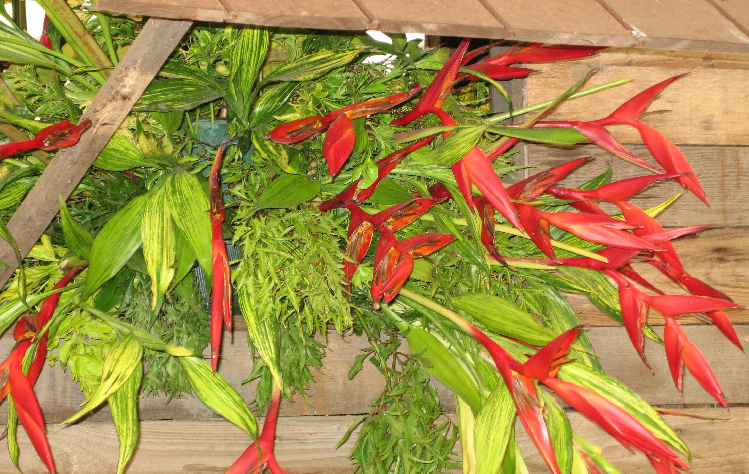
Chelsea ?
Sugar cane farmers rotated pure stand vegetables and root crops with sugar cane
Dr Colin Hudson designed and built planting and harvesting equipment
Medium-sized specialist vegetable farms appeared
Small farmers extended production from root crops to vegetables
Larger acreages grown - onions(250 ac. 1972), tomatoes (387 ac. 1979), carrots (943 ac. 1979)

Slide 20
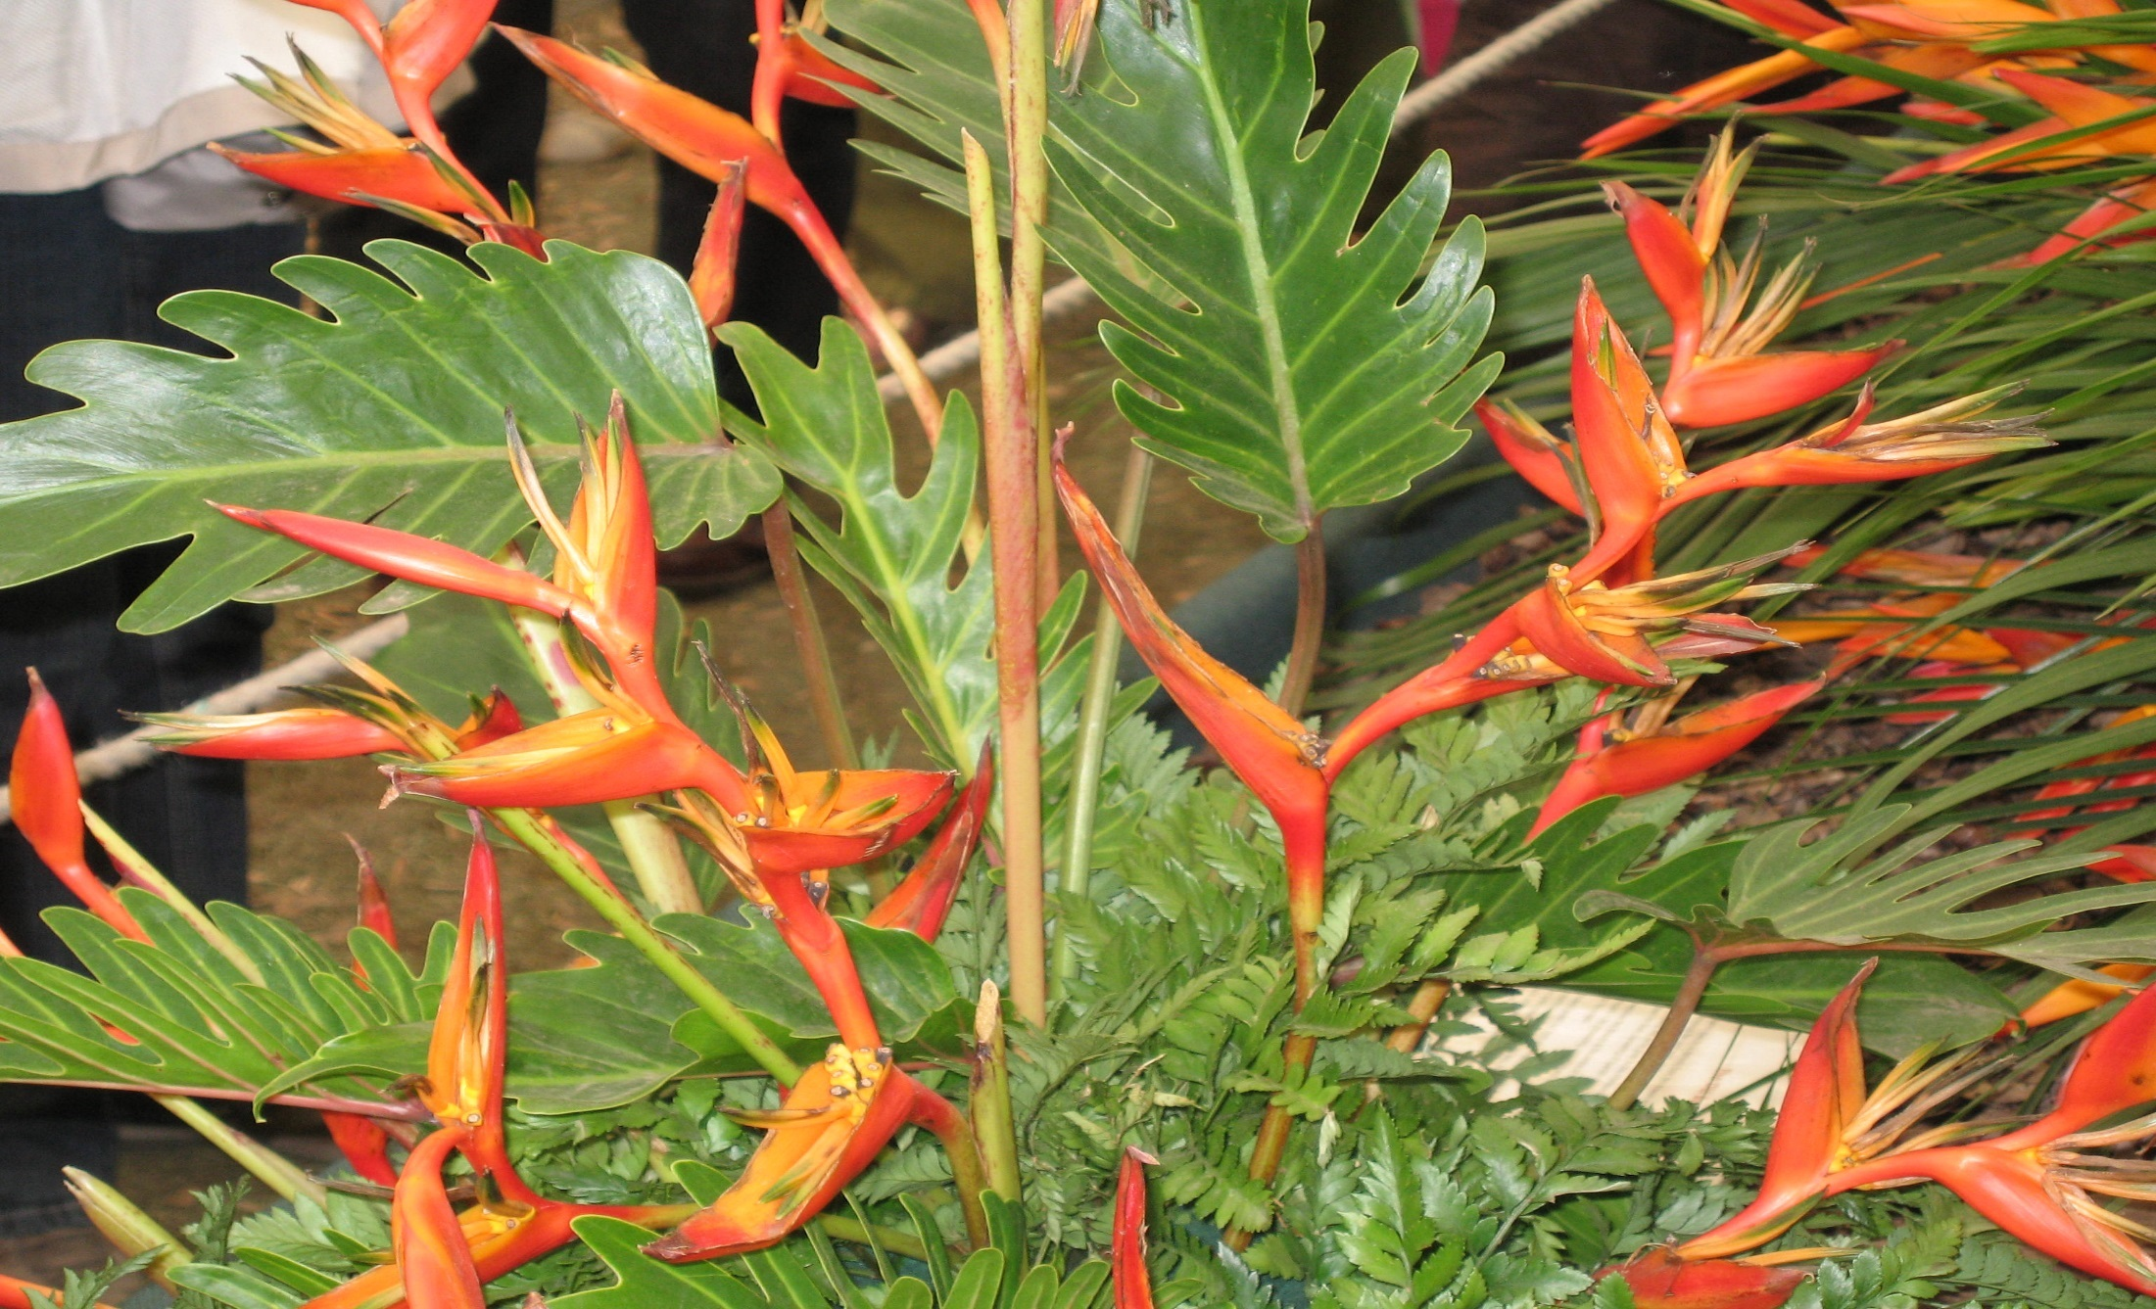
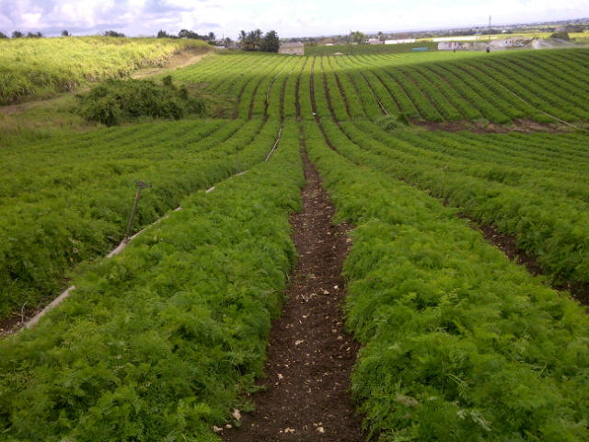
Chelsea ?

Slide 21
WHAT’S NEEDED FOR A WINNING CHELSEA EXHIBIT
Adequate financing
An attractive design
A talented, hard working team on site
Good supply of quality materials
Good backup team preparing materials
Proper handling, packing and shipping of materials
Timely receipt of materials

Slide 22
Quality Materials with a Long Shelf Life
What goes on in the greenhouse or field can determine the quality and life of cut flowers and foliage
Disease-free plants that were properly irrigated and fertilized will produce flowers that look better and perform better in displays

Slide 23
Quality Materials with Long Shelf Life
Low N and high K prior to harvest increases shelf life of anthuriums
High phosphorus leads to etiolation or stretching and will cause increased internode length and weak blooms
Low magnesium and iron will cause poor chlorotic and pale green foliage which will be susceptible to dieback spots and burnt tip in cool or low humidity conditions

Slide 24
Quality Materials for Long Shelf Life
Plants grown in the right light will ensure foliage and blooms are in the right proportion (not etiolated) and colour of bloom is not bleached.
Blooms and foliage will suffer from sunburn and this often only shows up days later when temperature and humidity of storage and shipping changes.

Slide 25
Quality Materials for Long Shelf Life
Flower/foliage quality can’t improve after harvest
Only the best quality must be picked and at the right time of day.
Conditions which will maintain good quality after harvest must be provided

Slide 26
Harvesting
Correct maturity of material is important
Gingers should be picked when 2/3 of the bracts are open. Trim all or all but the top one to three leaves from the stem in the field or at the packing shed prior to cleaning.
Heliconias will not develop further after harvest so must be picked at the stage at which they are to be used.

Slide 27
Harvesting
Ensure plants have been adequately watered and are turgid before harvesting flowers or foliage
Harvest early morning to reduce water lost to transpiration
Cut stems of gingers 60 – 100 cm. The longer the stems the longer the shelf life
Cut flowers with sharp secateurs to avoid mechanical damage to stems

Slide 28
Harvesting
Pack as soon after harvest as possible as cut flowers and foliage begin to deteriorate as the reserves of moisture and food present at harvest start to run out.
Shade product from direct sunlight between cutting and bringing to packing shed.

Slide 29
Post Harvest Treatment
Place stems into clean buckets of clean, cool water as soon as possible after harvest
Hard water (high pH) can cause drastic reduction in water movement in stems This problem can be overcome by making the
water acid (pH ~3.5). Citric acid is commonly used as a safe acidulant.
Some people have suggested using Sprite as it has phosphoric acid and a little sugar (not diet drinks)

Slide 30
Post Harvest Treatment
Buckets must be cleaned with bleach solution.
OR use Oxidate as it is safer .
Maybe Oxidate can be added to water to reduce the possibility of bacteria build up
Woody stems are more prone to bacterial plugging. Bacteria and other microbes that plug stems may be present even in tap water but are most abundant in water put into dirty containers

Slide 31
Local Transport
Cull any unsuitable stems
Keep stem bases in water during transport from the field to the packing area.
Promptly transport flowers in an air conditioned vehicle to a cool location for packing

Slide 32
Cleaning and Packing
Do this under as cool conditions as possible
Air embolisms result when small air bubbles are drawn into the stem at cutting or during dry storage and block later flow of water up the stem, so that the flower wilts.
Remove embolisms by re-cutting stem, at an angle, while the stem remains under water.

Slide 33
Cleaning and Preparation
Treat material gently during cleaning and preparation to avoid mechanical damage which will show up later in the journey. Wounded material will also produce ethylene gas which can cause leaf drop in foliage of some plants

Slide 34
Cleaning and Preparation
In the field, red ginger is often heavily infested with ants, aphids, soft scales, and mealybugs. If left unchecked, pest buildup can make postharvest disinfestation
time-consuming and difficult.
A combination of pest management in the field and treatment after harvest is recommended

Slide 35
Cleaning and Preparation
Dip material in a dilute solution of Malathion to control any insect pests that may be present
Rinse in clean water
Allow material to air dry (upside down) before packing as moisture may lead to blackening of flowers like gingers.

Slide 36
Packing
Long ventilated customized cardboard boxes are recommended
Flowers are wrapped in shredded paper to cushion them from injury during any shifting, and laid with the heads of alternate layers at alternating ends of boxes
Sheets of paper may be placed between layers for insulation against temperature changes and to absorb condensation which can freeze if temperatures get too low.

Slide 37
Packing
Too tight packing of flowers/foliage must be avoided.
The heads of the flowers should be placed 6 to 10 cm (2.4 to 4 in) from the
end of the box to allow effective precooling and to eliminate the danger of petal bruising should the contents of the box shift.

Slide 38
Air Transport Temperatures
Species that grow naturally in tropical climates need storage temperatures (minimum 10°C) but preferably 15 to 17 deg C to avoid chilling injury which results in greyish or bluish blooms in gingers.
It is recommended to inform flight crew that there are ornamentals on board, as they can usually control the temperature in the cargo holds.

Slide 39
Air Transport Temperatures
Fluctuating temperatures can lead to poor condition on arrival ,even though they may have been in a top-quality condition when they were packed.
Tropicals should be kept away from the direct blast of cold air during shipment.
Small temperature loggers may help to determine temperatures during shipment.

Slide 40
Arrival in UK
Every effort must be made to clear the shipment as promptly as possible to ensure that it is not exposed to too low temperatures
Upon arrival the basal 2–3 inches of stems should be cut off and the stems placed in warm water
A holding solution of 2% sucrose (w/v) is recommended. Sugar will extend shelf life by at least a week.

Slide 41
Rehydration of Foliage
Rehydration of foliage essential
Possibility that water used to submerge too cold. Some foliage can’t take this change - especially some Aralia and Asparagus- so the shock causes leaf abortion or irreparable dehydration.
Maybe submerged too long
A lot of foliage lost each year
Needs to be discussed firmly and agreement reached on correct procedure

Slide 42
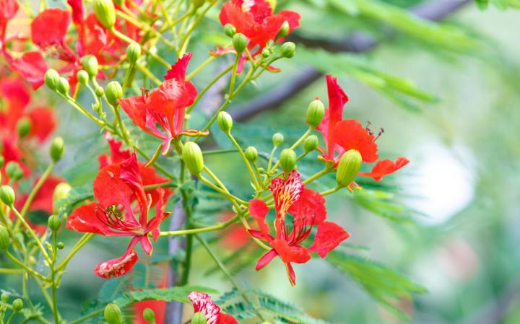
Thank You!

